Slide 1
Hackathon
Experian Realty Connect

Slide 2
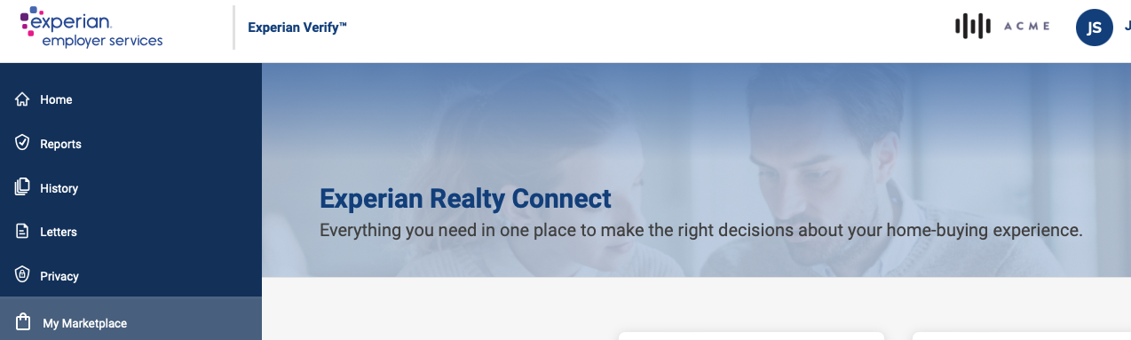
Experian Realty Connect
Everything you need in one place to make informed decisions and improve your home buying experience.

Slide 3

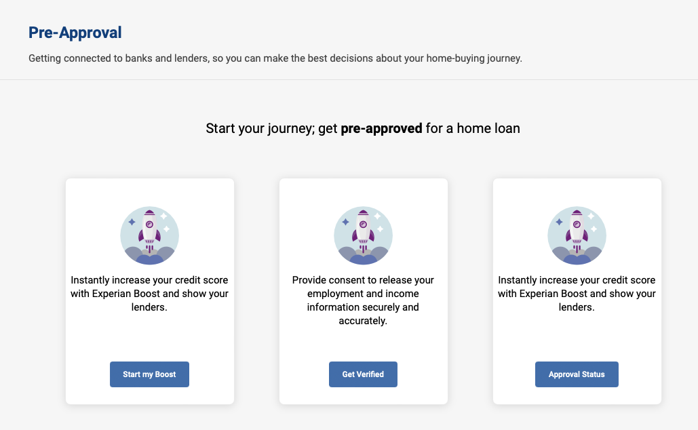

Maximize your pre-approval by boosting your credit score with Experian Boost
Instantly share your employment and income with lenders in your area.
View your pending requests and pre-approval offers from lenders.

